Slide 1
Online shopping cart system

Slide 2
Overview of problem:-
Travel and commute: Offline shopping requires physically traveling to the store, which can be inconvenient for those who do not have easy access to transportation.
Limited store hours: Physical stores usually have fixed operating hours, which may not always be convenient for all shoppers.
Returns and exchanges: Returning or exchanging products purchased offline can be more complicated compared to online shopping, as it may require physically visiting the store again and adhering to the store's return policy, which may be less flexible compared to online retailers.
Limited product selection: Physical stores may have limited space, which means they cannot carry all the products or variations that online retailers can offer.

Slide 3
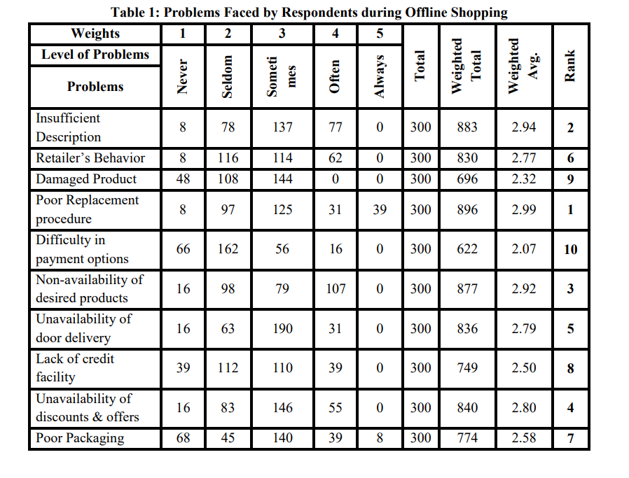
research
Problems Faced by Respondents during Offline Shopping Customers indicated various problems faced by them during offline shopping as presented in table .

Slide 4
solution

Slide 5
Implementation using hash table
Define a hash table data structure to store the items in the cart. The hash table can be implemented as an array of buckets, where each bucket contains a linked list of items with the same hash value
When a user adds an item to the cart, compute the hash value for the item's unique identifier using the hash function. Use the hash value to determine the bucket in the hash table where the item should be inserted.
When a user removes an item from the cart, compute the hash value for the item's unique identifier using the hash function. Use the hash value to determine the bucket in the hash table where the item is stored.
Search the linked list in the bucket to find the item. If the item is found, remove it from the linked list. If the linked list becomes empty after removing the item, update the hash table to mark the bucket as empty.

Slide 6
Other data structure used
Arrays: Arrays can be used to store product information, user details, and order data in a linear manner, allowing for efficient retrieval and updates based on index values.
Linked Lists: Linked lists can be used to implement dynamic data storage for product information, user details, and order data, allowing for efficient insertion, deletion, and updates operations.
String: are used for creating the login account and inserting the name of user and setting the password to the login account

Slide 7
Future significance and benefits
An online cart system enables businesses to reach a wider customer base beyond geographical boundaries
By providing a seamless and user-friendly shopping experience, an online cart system can lead to increased sales.
With the increasing use of smartphones and mobile devices, the future of online cart systems is likely to be mobile-centric. Mobile commerce, or m-commerce, is expected to grow significantly.
Future online cart systems are expected to have advanced security measures, such as multi-factor authentication, encryption, and fraud detection, to protect customer data and ensure secure transactions.

Slide 8
Research Papers Reference
Links of the research papers that we get from online platform:
https://www.google.com/url?sa=t&source=web&rct=j&url=https://core.ac.uk/download/pdf/5165156.pdf&ved=2ahUKEwif5PPNubH-AhUGqVYBHV4zCmkQFnoECBsQAQ&usg=AOvVaw3Lq9okdcml98TzlXsHbNFt
https://www.google.com/url?sa=t&source=web&rct=j&url=http://dspace.cusat.ac.in/jspui/bitstream/123456789/8252/1/onlineshoppingsystem.pdf&ved=2ahUKEwif5PPNubH-AhUGqVYBHV4zCmkQFnoECBgQAQ&usg=AOvVaw0XPPvA8xDSqwIYHSaJDtsA

Slide 9
Project by:-
Pawan aru –mis- 112103013 s1
Paras Bhosale- mis-112103025 s2
Soham dorage-mis-112103040 s3

